Slide 1
Mechanism
Basic Tools and Supply Chain
Notes:
Main Title Page

Slide 2
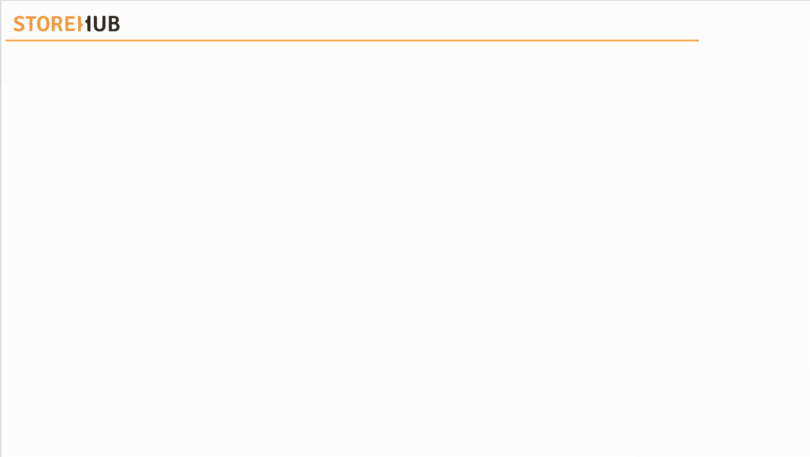

| Mechanism
Directory Index
Date | Updates | Version | PIC

Slide 3


| Mechanism
Overview
Tools
Supply Chain

Slide 4
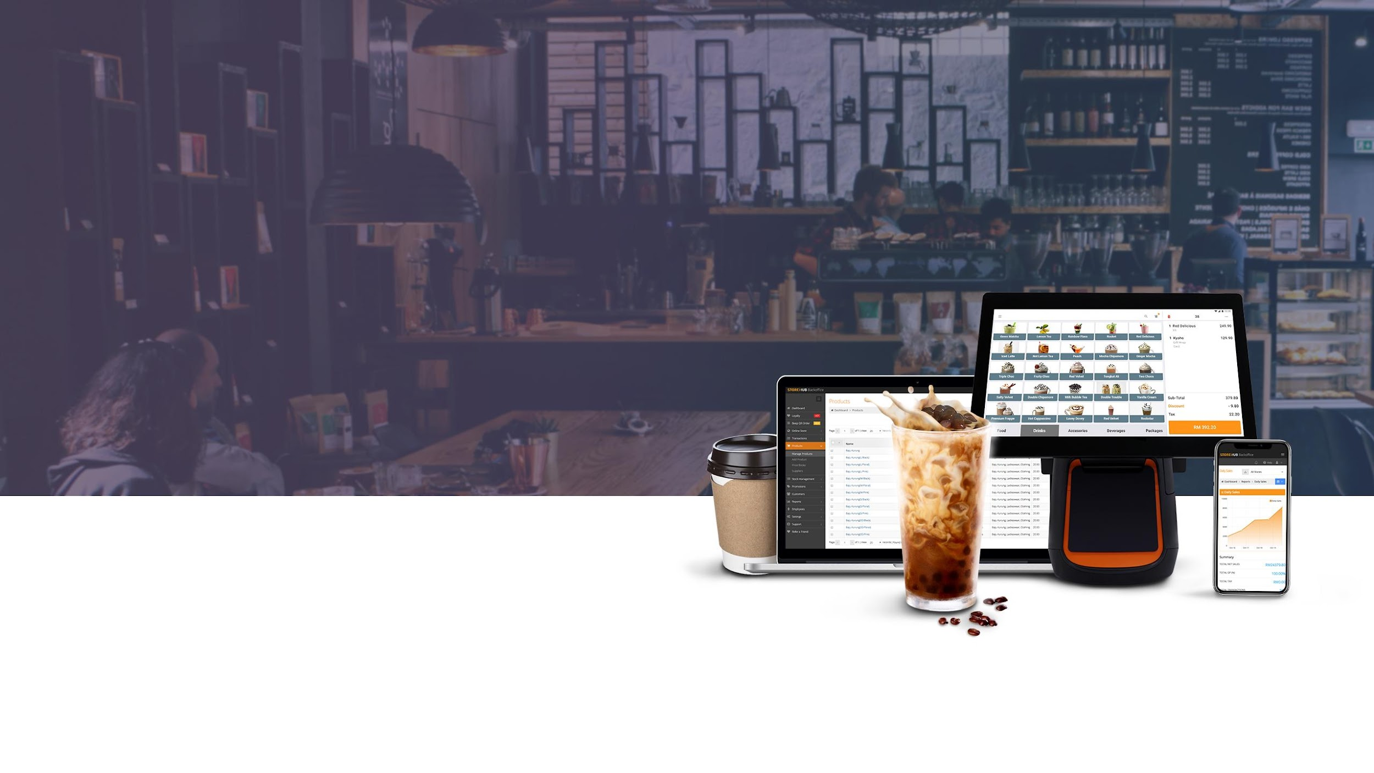
Tools

Slide 5







| Mechanism
Main Tools
Internal Support Tool
Salesforce
Knowledge Base
Chargebee
Forms
Intercom
Adobe Illustrator

Slide 6


[ Team Using : All ]

Slide 7

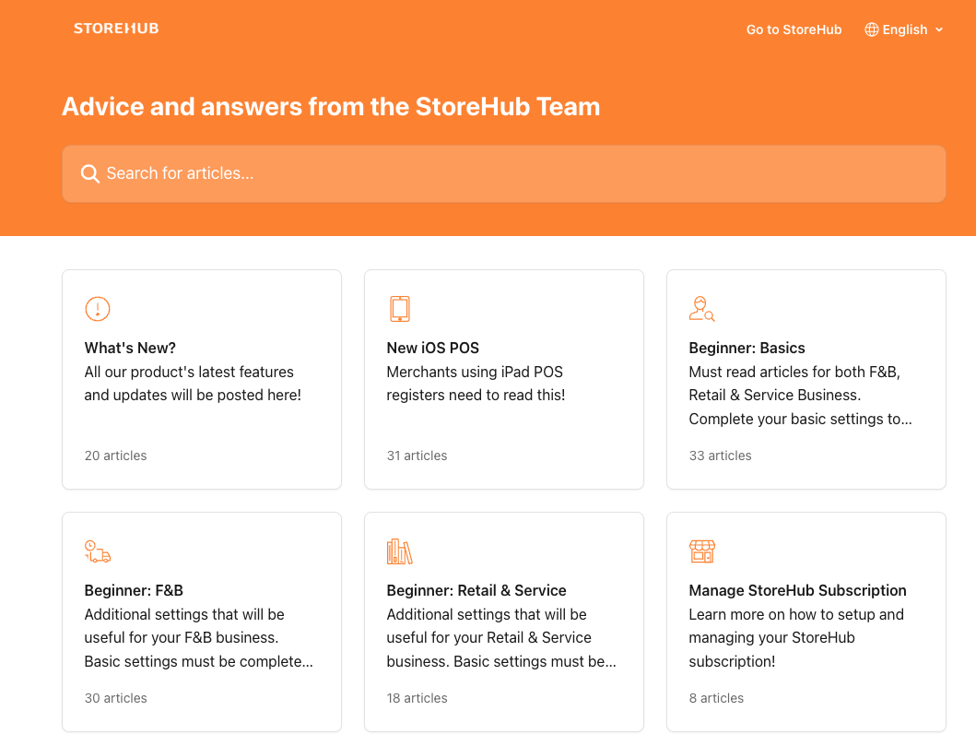
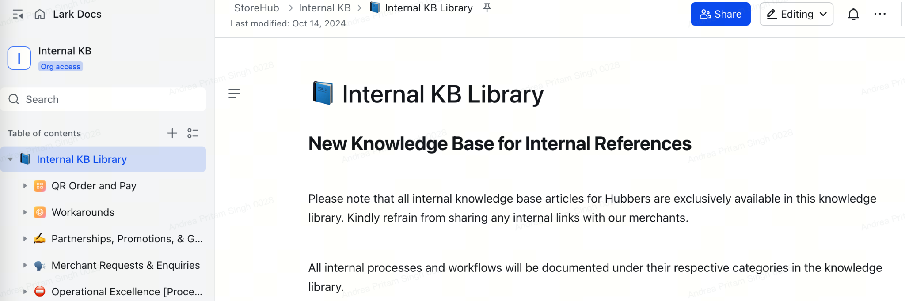
Knowledge Base
Introduction
Internal Knowledge Base Library
Available at https://care.storehub.com/en/
Available at StoreHub Internal KB
KB = Knowledge Base

Slide 8
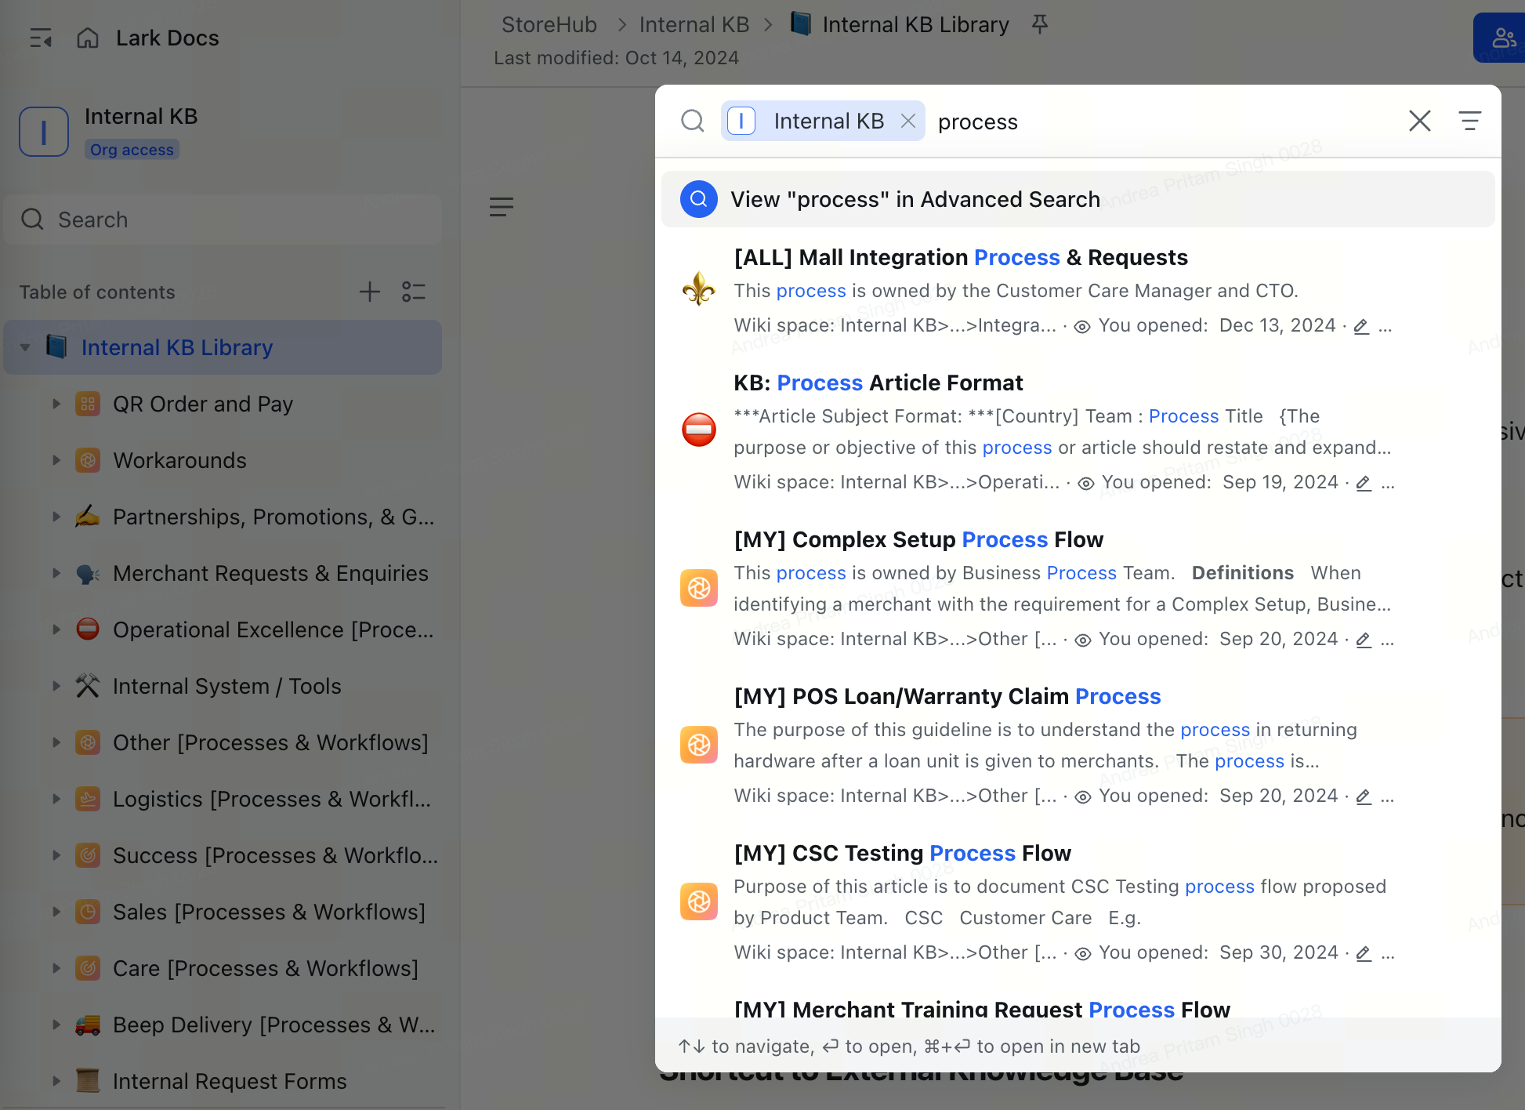
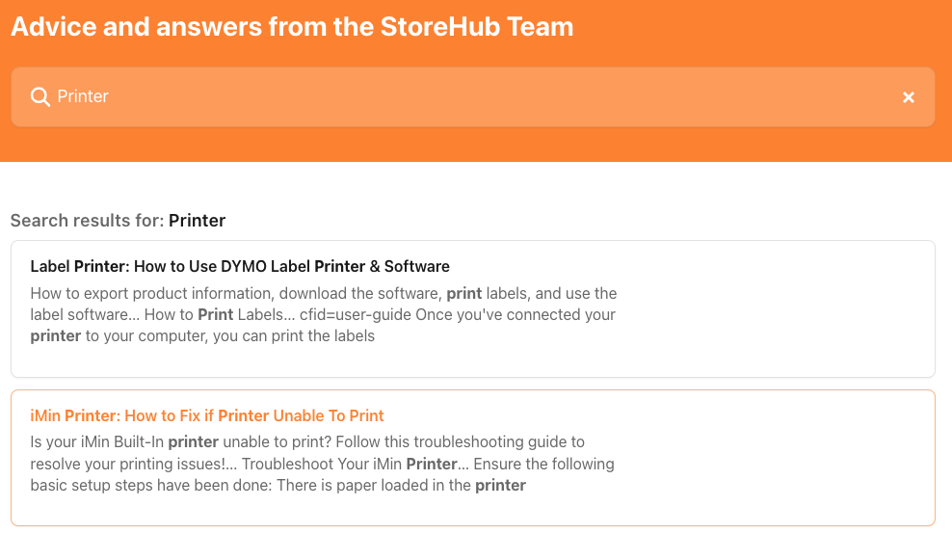
Knowledge Base
Navigation (cont.)
Internal KB Library
Search Result
Search Result
Note : Do not share articles from Internal KB Library to public
Articles maintained by Technical Training team
KB = Knowledge Base

Slide 9
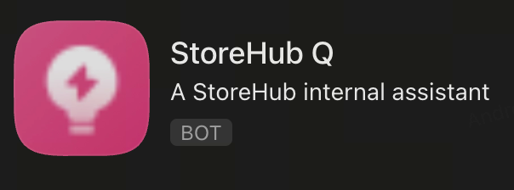
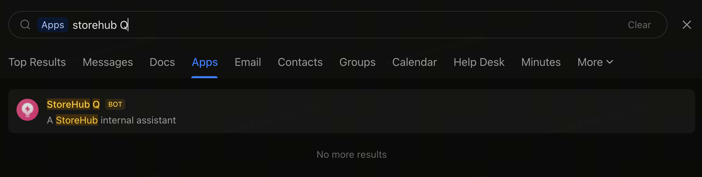
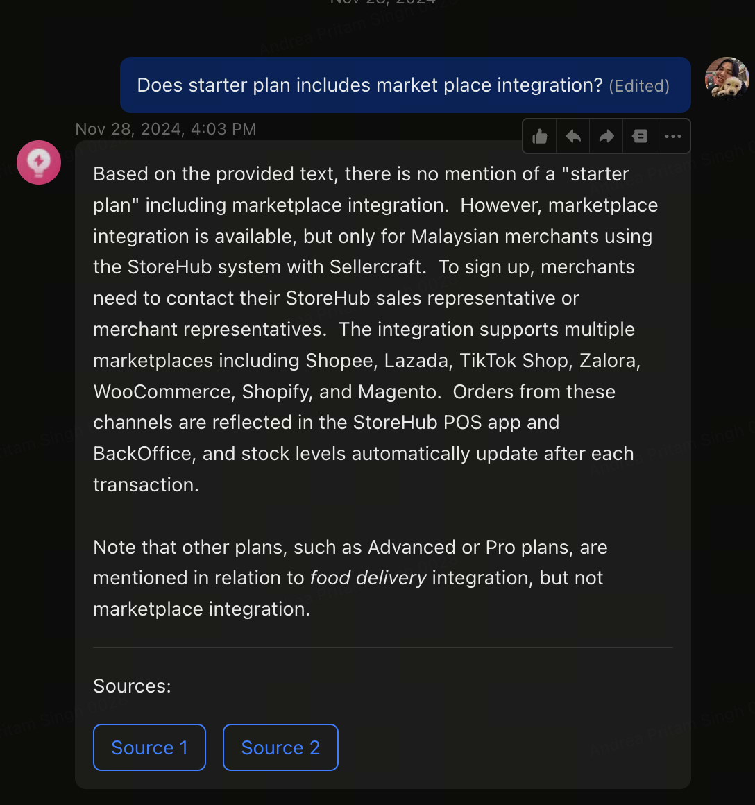
Knowledge Base
Navigation
Search for StoreHub Q on Lark
Have a question about StoreHub? Just ask StoreHub Q for answers!
What is StoreHub Q?
StoreHub Q is an AI-powered assistant designed to gather information from StoreHub’s resources, helping you provide accurate and efficient answers.
KB = Knowledge Base

Slide 10

IST – Internal Support Tool
Notes:
Change slide

Slide 11

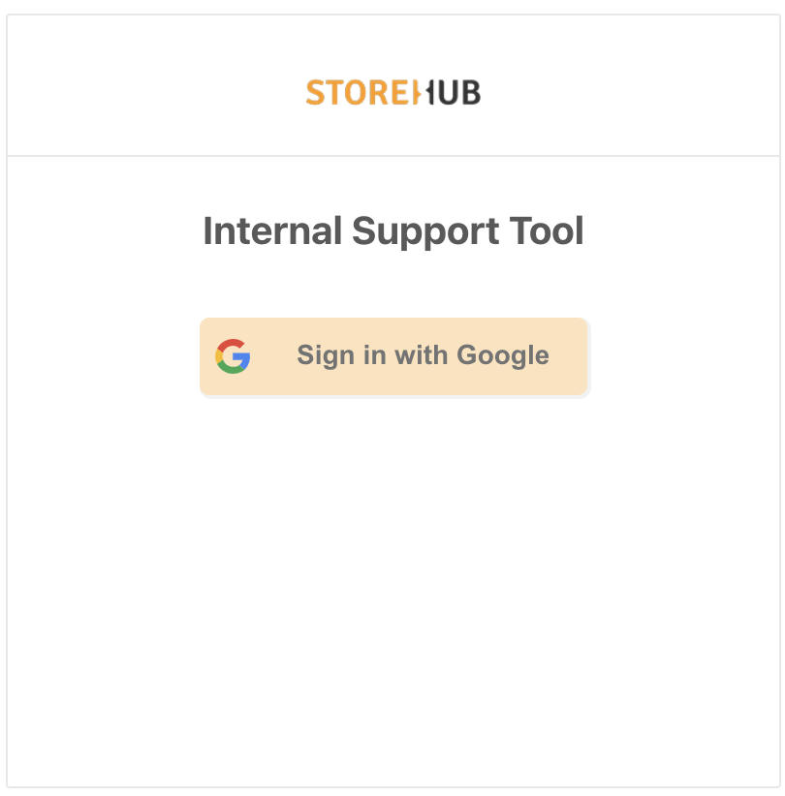


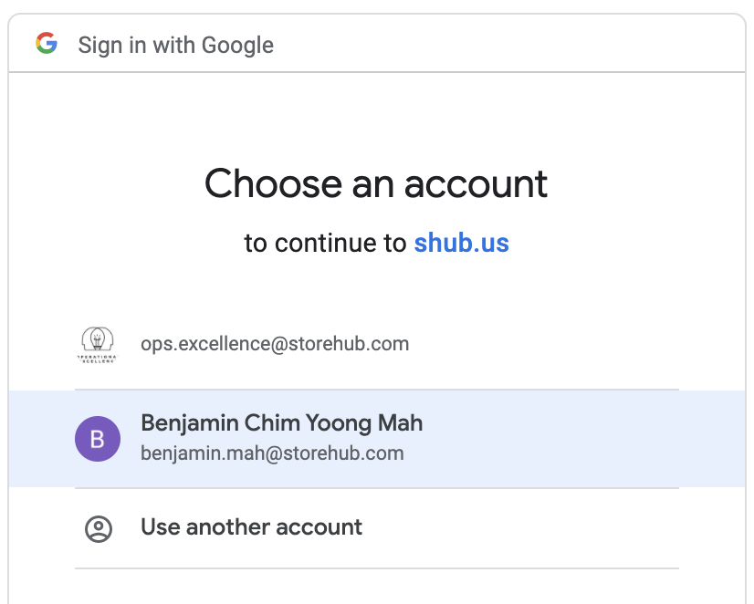
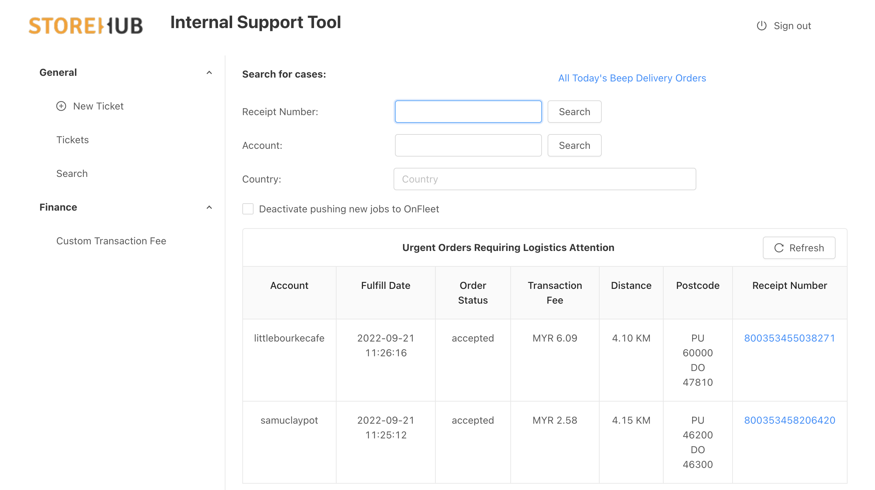
IST – Internal Support Tool
Internal
Support
Tool
Introduction
Login
Links:
https://internal.shub.us/logistics/dashboard
Functions
Create Temp. Employee Access
Transferring Ownership
Tag Management

Slide 12
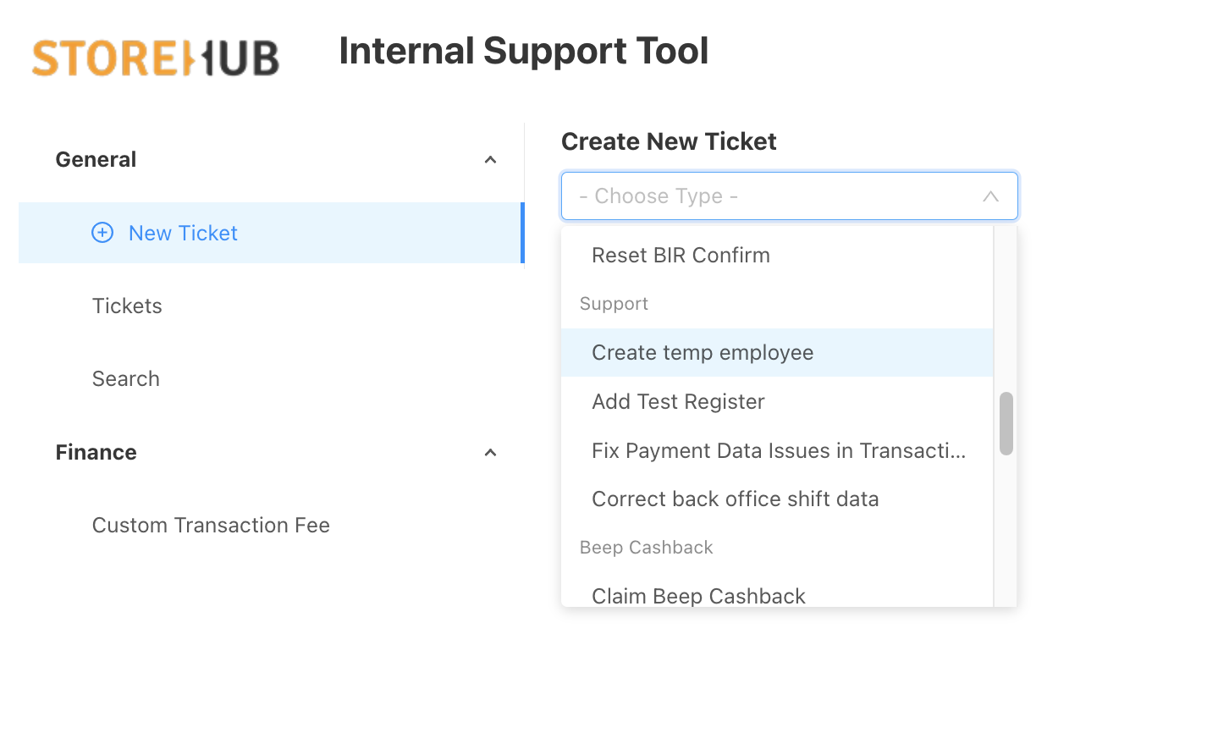
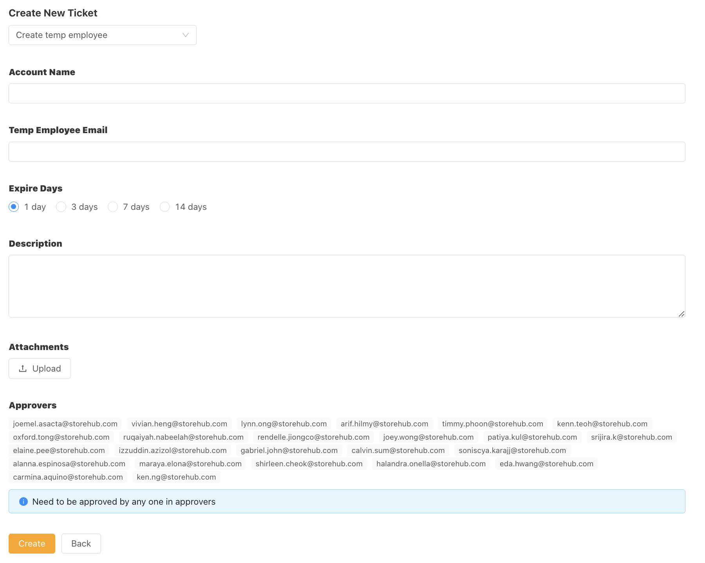
IST – Internal Support Tool
Internal
Support
Tool
Temporary Employee Access
Details
Submit an IST to request temporary access to the Merchant BackOffice for their work.
This request requests will be approved by your coaches.
Notes:
803907798012155

Slide 13
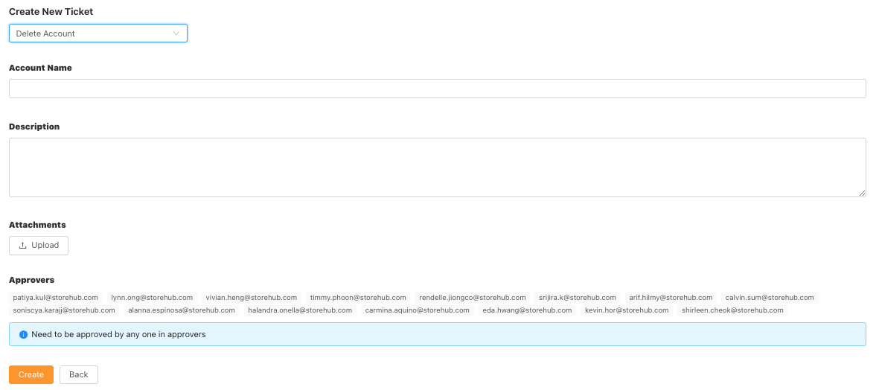
IST – Internal Support Tool
Internal
Support
Tool
Delete Account
Details
Submit an IST to delete an account for situations if merchants:
Inserted wrong business name.
Wants to reset account
Notes:
803907798012155

Slide 14
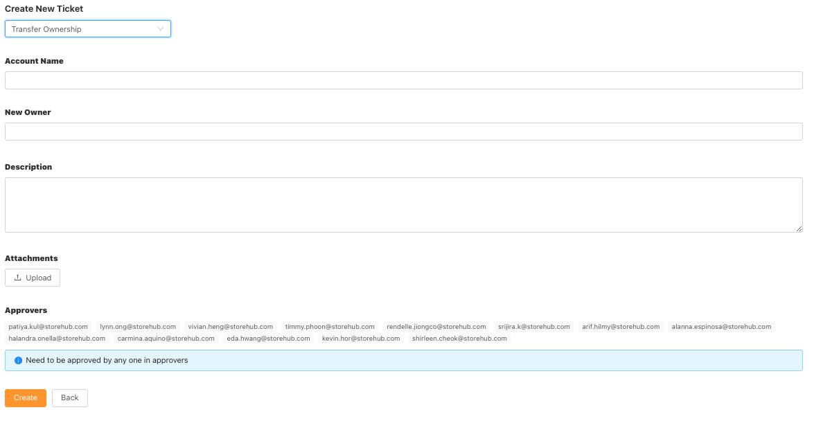
IST – Internal Support Tool
Internal
Support
Tool
Transfer Ownership
Details
Submit an IST if merchants wants to transfer ownership to another merchant.
Notes:
803907798012155

Slide 15
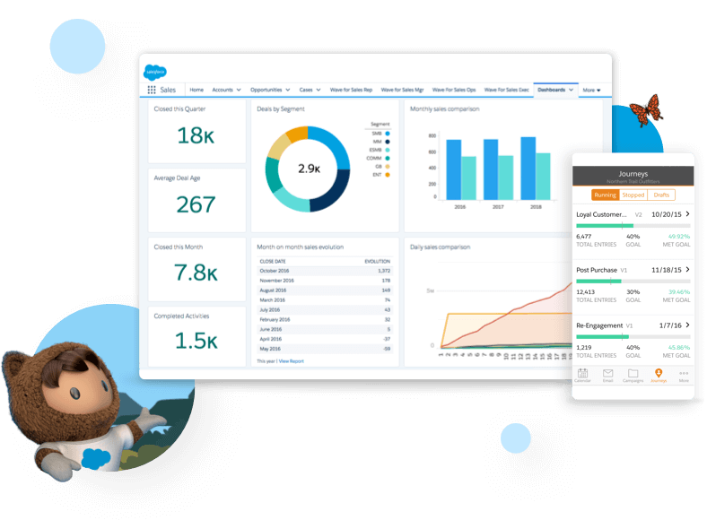

Salesforce
[ Team Using : Sales/Success/Care ]

Slide 16

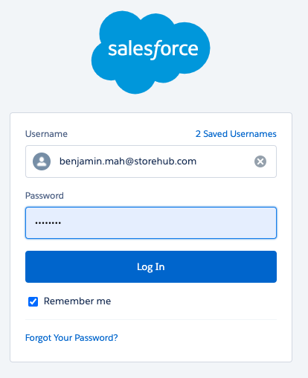
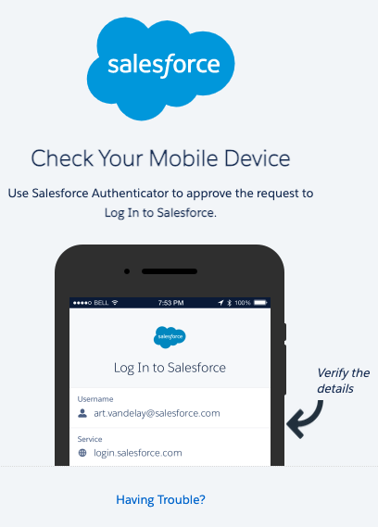
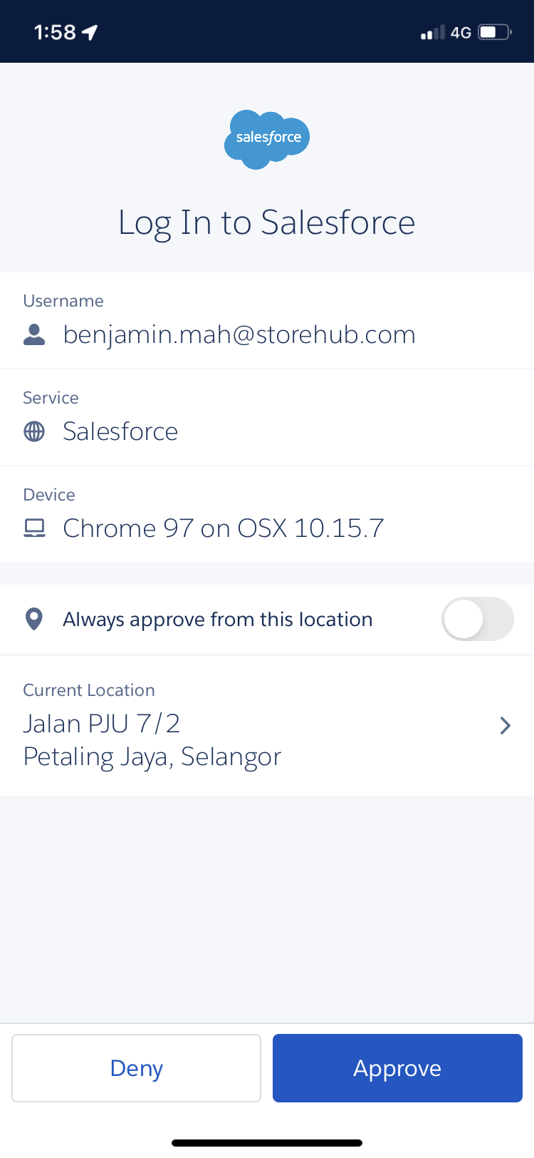
Salesforce
Login
https://storehub.my.salesforce.com/
Verify authentication by downloading Salesforce Authenticator app
Click approve on Authenticator app

Slide 17
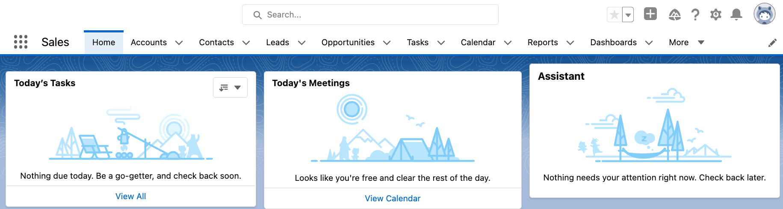
Salesforce
Introduction
Intro
Function
Used by
Managing merchant’s StoreHub journey
Lead > Won > Onboarding
Qualifying leads
Merchant’s information
Onboarding schedule
Hardware tracking
Sales Team
Success Team
Care Team

Slide 18
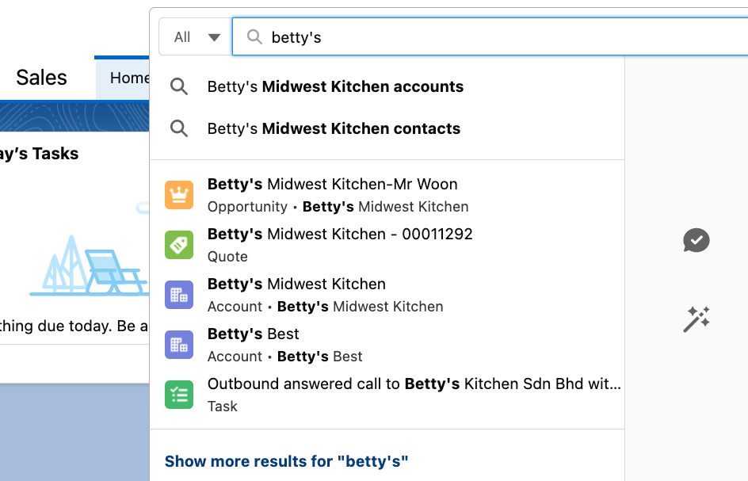
Salesforce
Navigation (cont.)
Search Input :
Account name
Email
PIC
Select Salesforce Objects:
Lead - New Lead (Qualified/Unqualified)
Opportunity - Meeting Completed by BC (Won/Lost)
Account - Overview of merchant’s Account Details
Contact - Merchant’s Contact Info
PIC = Person in Charge

Slide 19
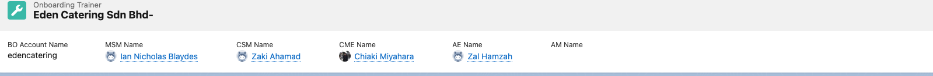
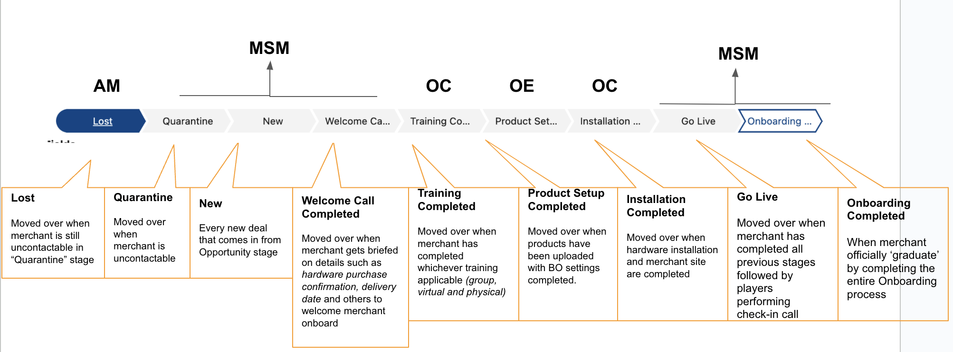
Salesforce
Navigation (Onboarding Trainers)
Name of Assigned:
CSM (Onboarding Consultant),
CME (Onboarding Executive)
Merchant Success Manager (MSM)
Business Consultant (BC)

Slide 20
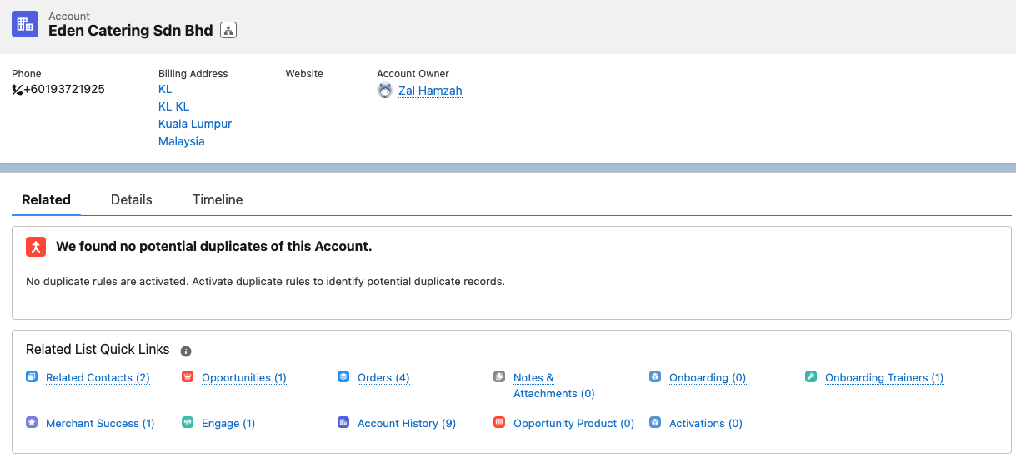
Salesforce
Navigation (Account)
Opportunities can be found under Account
Onboarding Pipeline
PIC = Person in Charge

Slide 21
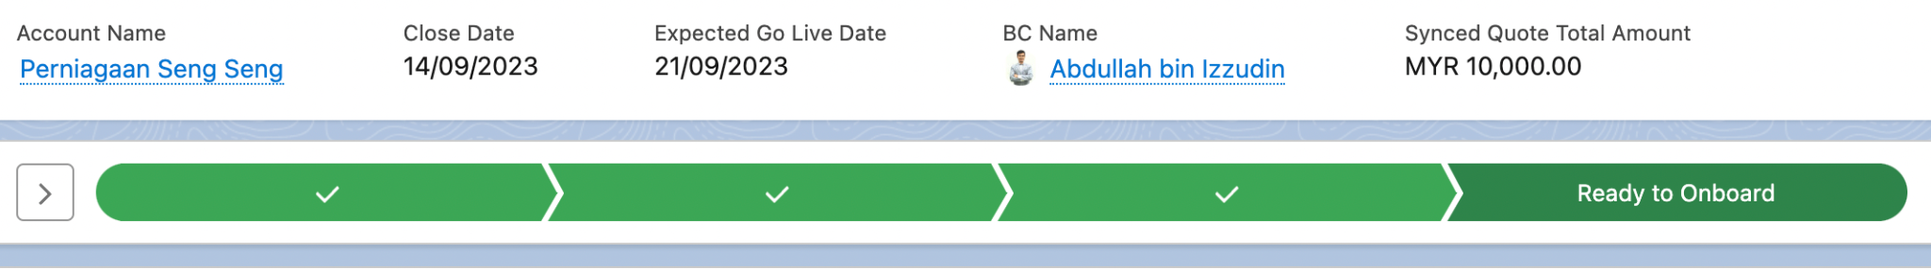
Salesforce
Navigation (Opportunity)
Paid Subscription: Account is still in the Sales pipeline.
Ready to Onboard: Already pushed to the Onboarding team to complete the checklist

Slide 22
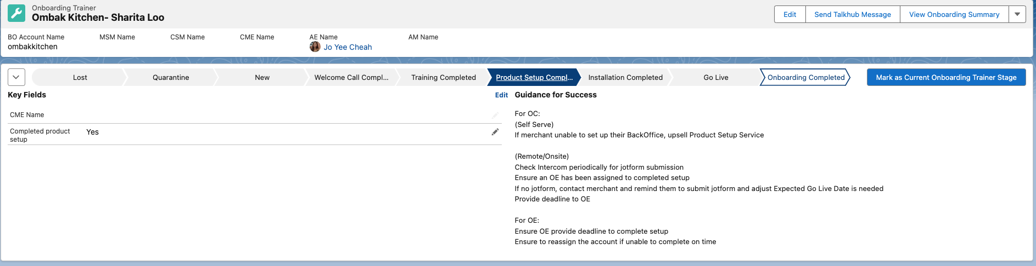
Salesforce
Product Setup Completed Stage
OE is responsible of the account at this stage.
Once OE must mark stage to Mark as Current Onboarding Trainer Stage after completion of Product Setup.
PIC = Person in Charge

Slide 23

Salesforce
Video

Slide 24


[ Team Using : Account Management / Care ]

Slide 25
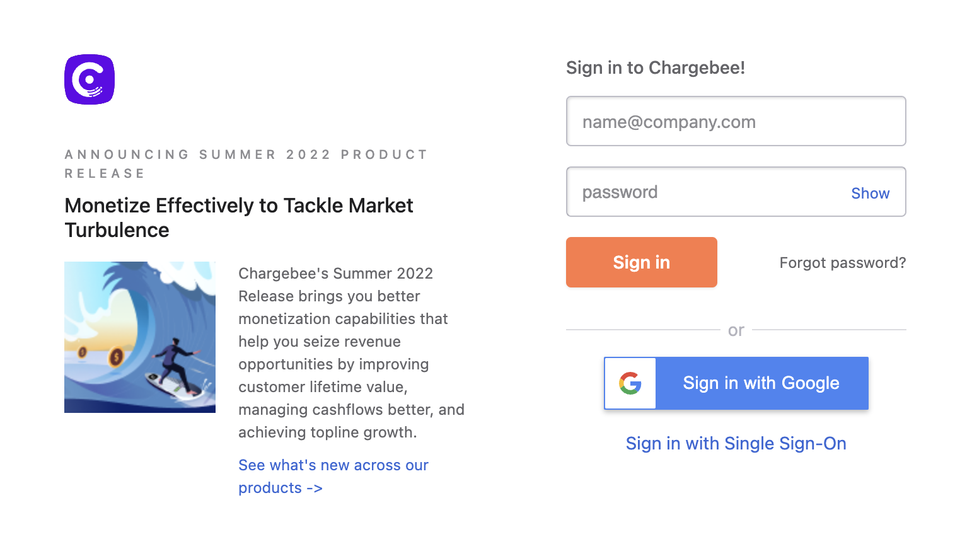
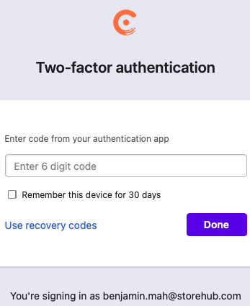
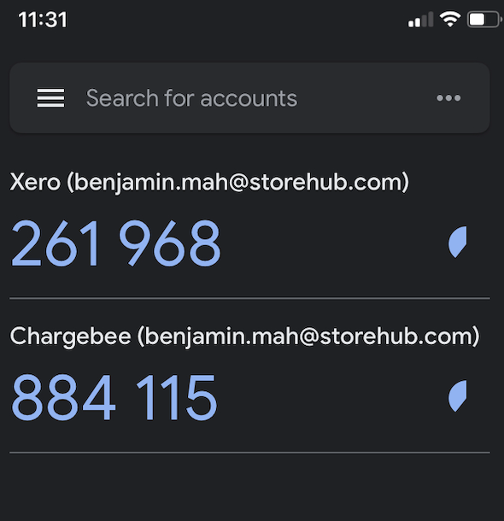
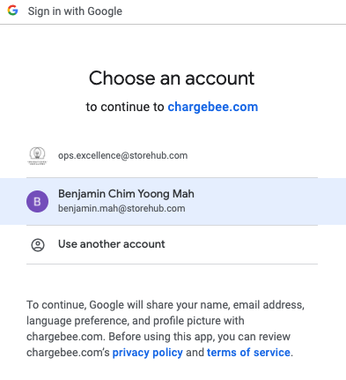
Chargebee
Login
https://app.chargebee.com/
Verify authentication by downloading Google Authenticator app
Once added, key in the same 6 digit code in the web page
Sign in with Google account
App = Application

Slide 26
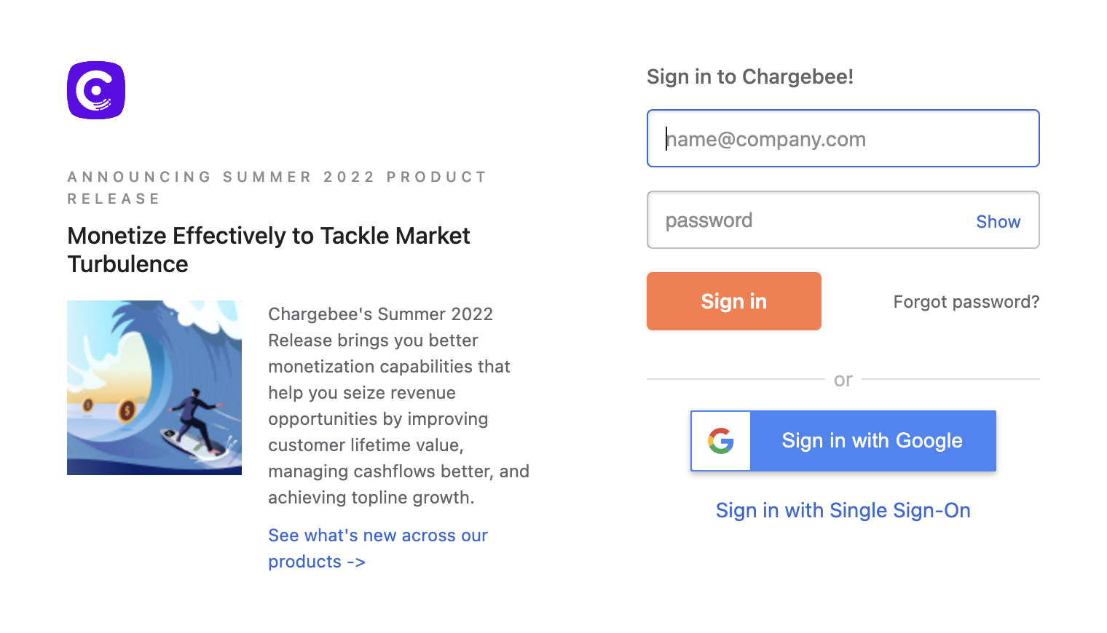
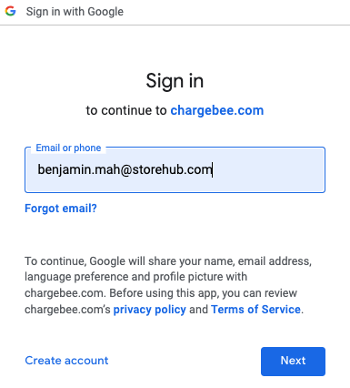
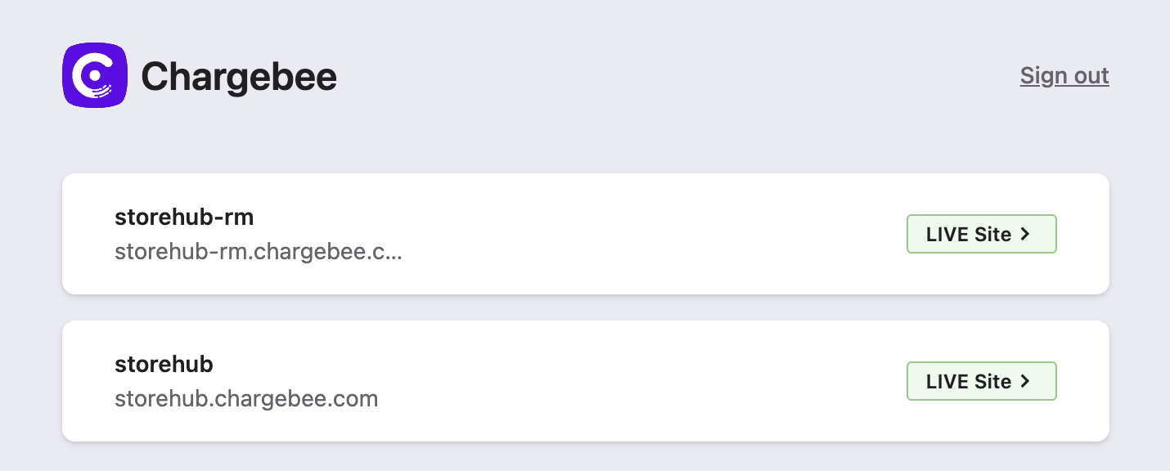
Chargebee
Introduction
Login
https://app.chargebee.com/
Functions
To Activate account subscription before product setup.
storehub-rm.chargebee.com
[Malaysian accounts only]
storehub.chargebee.com
[All accounts except Malaysian account]

Slide 27
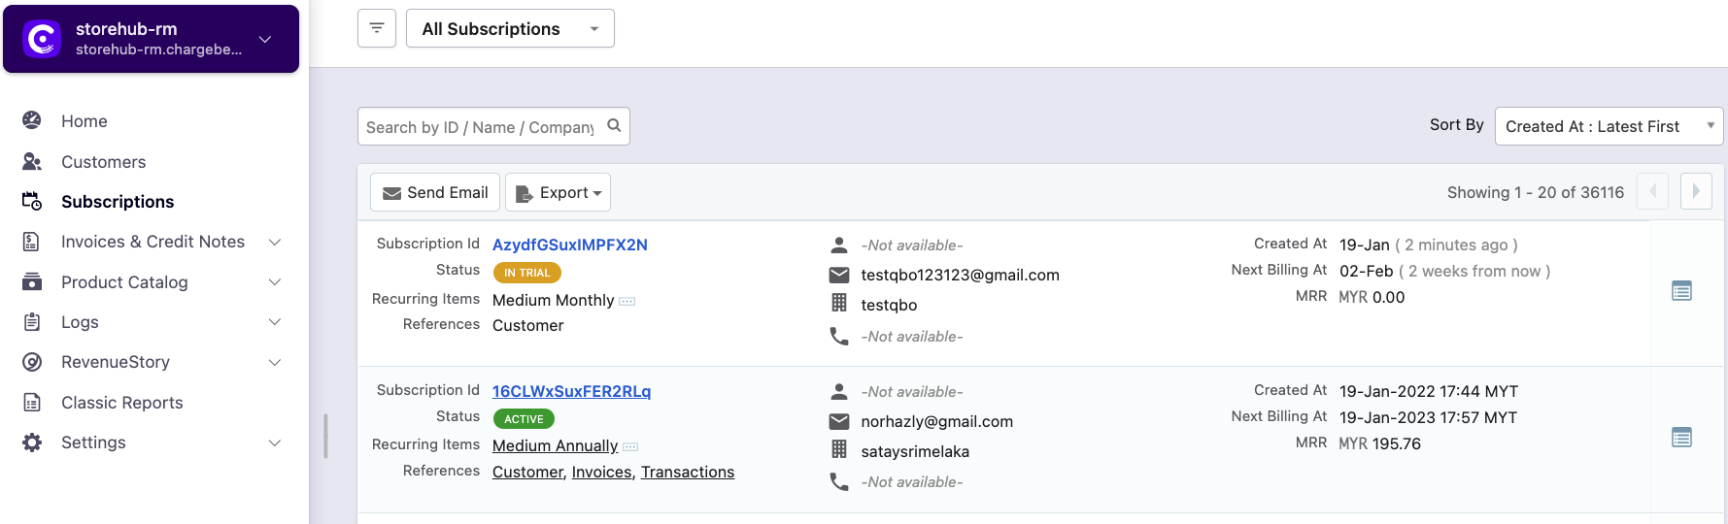
Chargebee
Navigation
Customers
Subscriptions
View contact information of merchant
Limited information on merchant subscription details
Merchant’s detailed subscription information
View charges and payment information of subscription

Slide 28
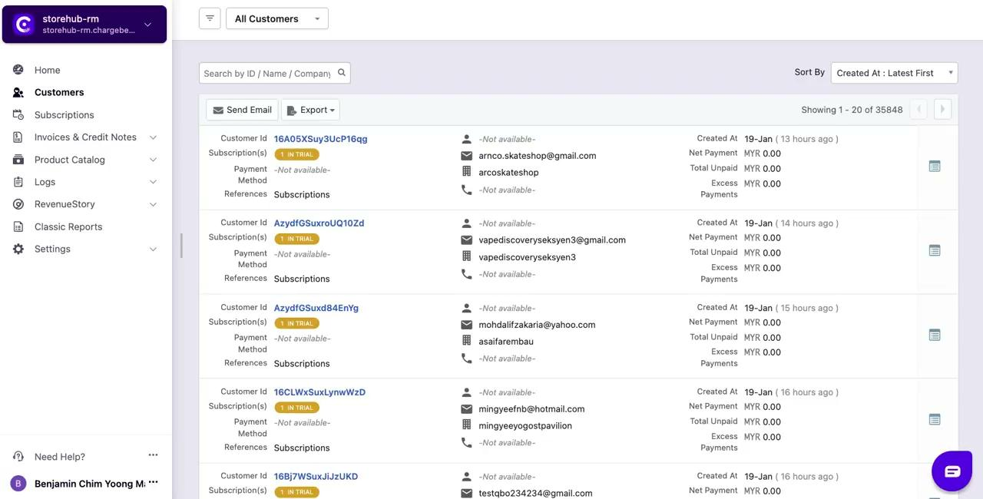
Chargebee
Navigation - Video

Slide 29
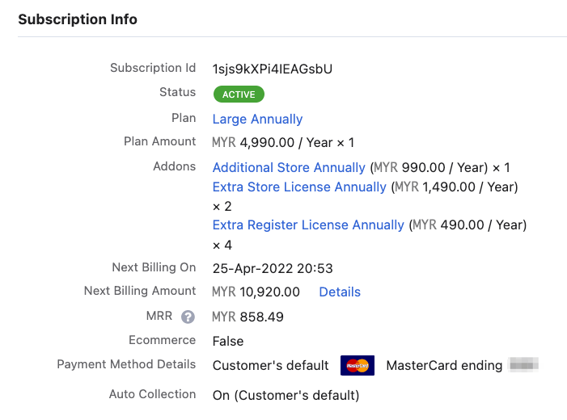
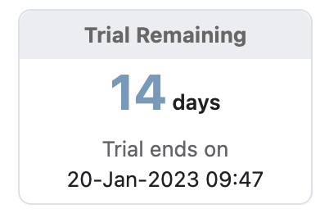



Chargebee
Subscription Details
Active
Merchant’s plan is still active
Cancelled
Merchant cancelled their plan
In Trial
Merchant recently register with StoreHub
Merchant Subscription Plan (Annually / Monthly)
Small: Starter Plan
Medium: Advance Plan
Large: Pro Plan
Base Plan: Base Plan
Additional Store [Extra store license]
Country | Pricing (Yearly)
 | MYR 1,490
 | PHP 490
 | THB 12,500
Additional Register [Extra POS terminal in existing store]
Country | Pricing (Yearly)
 | MYR 490
 | PHP 190
 | THB 6,000
SH = StoreHub

Slide 30
Chargebee
Account Activation Video
SH = StoreHub

Slide 31
Intercom (OE)

Slide 32

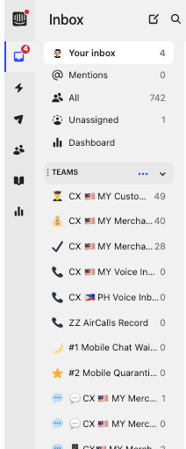
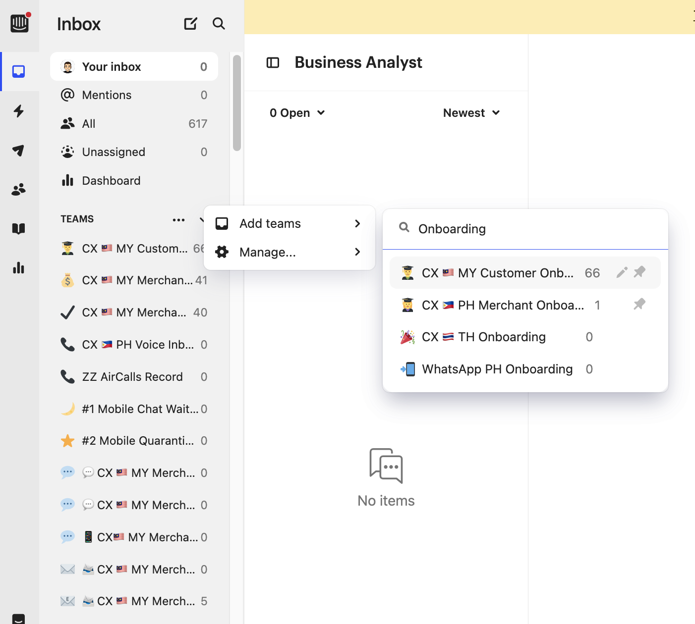
Intercom
Team Search
When to use?
When players wish to locate team and retrieve conversations
Team Search
On the Intercom ‘Inbox’ tab, search for ‘Teams’ option
Hover cursor over to 3 dots button and click on it
Select ‘Add teams’ then type and search for “CX 🇲🇾 MY Customer Onboarding”

Slide 33
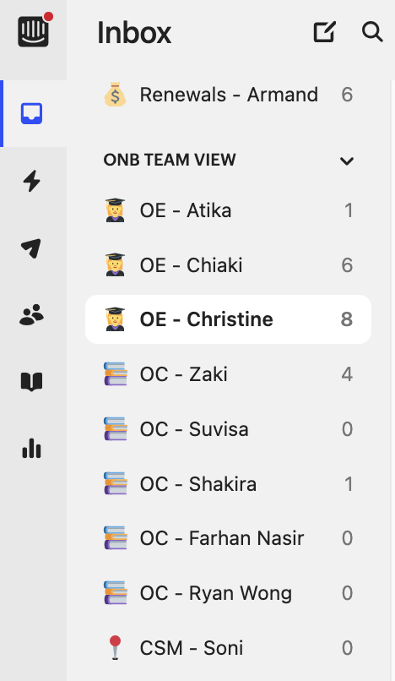
Intercom
Onboarding (ONB Team View)
When to use?
When players wish to check their own bucket or specific teammates’ bucket
ONB Team View
On the Intercom ‘Inbox’ tab, search for ‘ONB Team View’ Option
Select the desired OE/OC’s name
Players can claim tickets from the bucket themselves, and coaches only step in for urgent cases.
Players will occasionally chat within the team to practice Round Robin.
OE = Onboarding Executive | OC = Onboarding Consultant

Slide 34

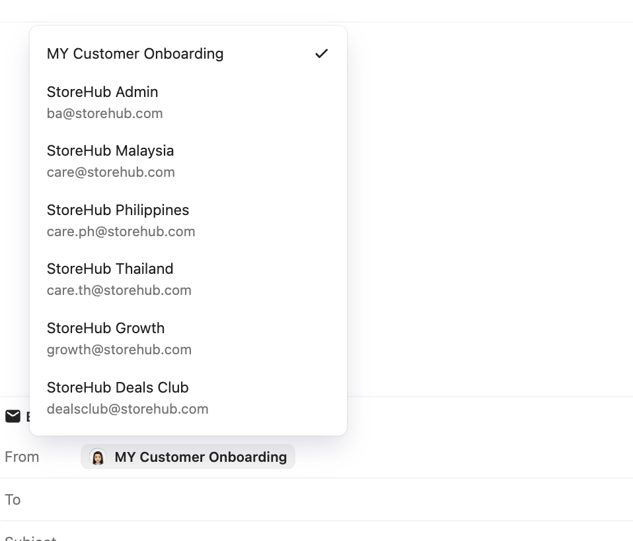

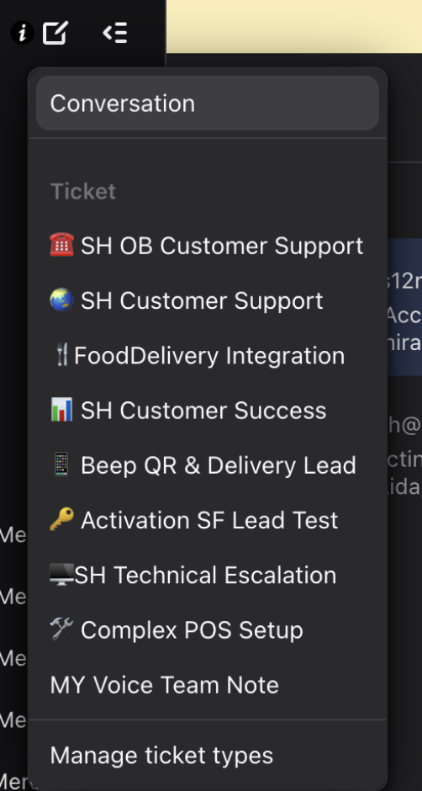
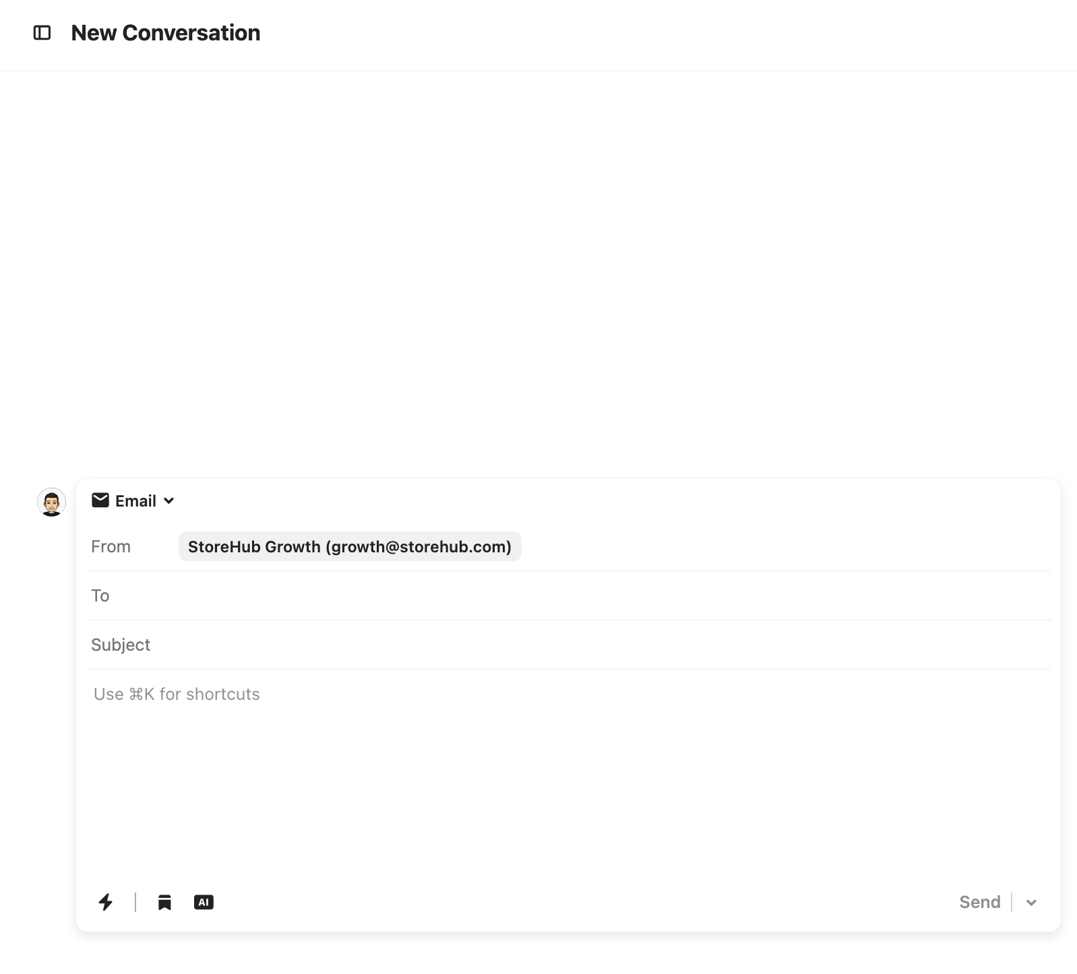
Email
Creating Outbound Email
4
1
2
Steps
Create a new box conversation
Select “Conversation”.
Select “Email”.
Select ‘MY Customer Onboarding’
Fill in Subject > Type in the content > Send
3
5

Slide 35
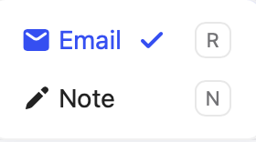
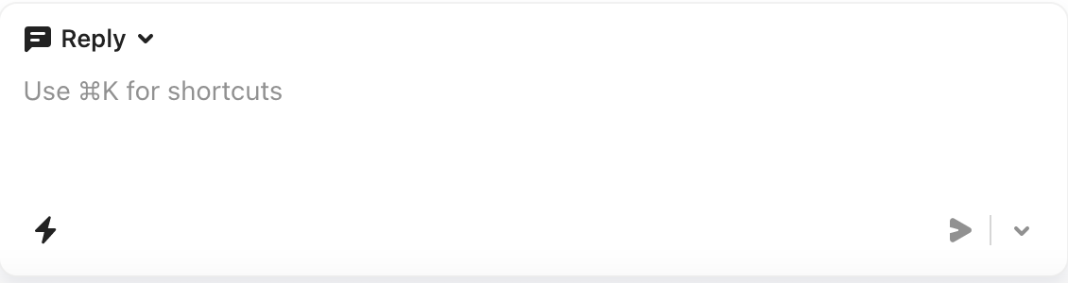
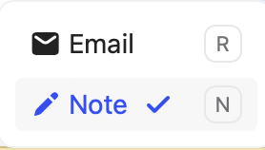
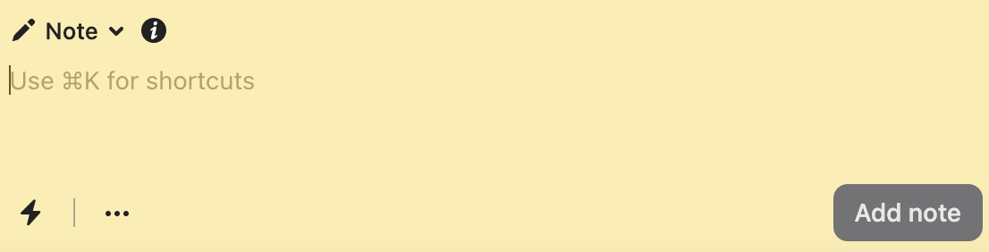
Email
Reply vs. Note
Reply
Player reply to customer tickets by adding contents
Internal Note
Player leave internal note for the case (It is not visible to merchant / customer view)

Slide 36
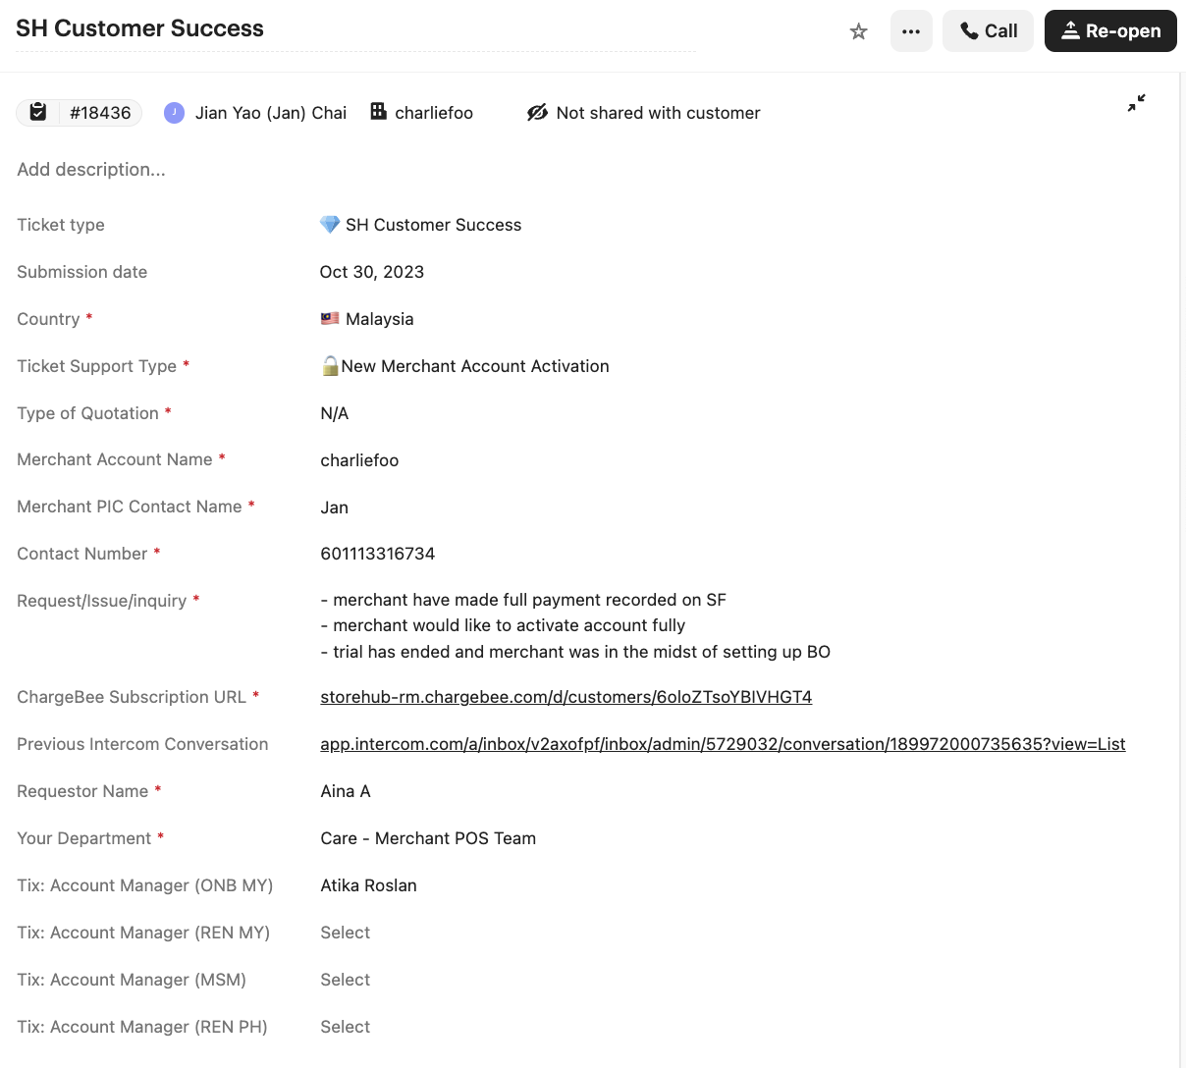
Intercom
Conversation Type
New Merchant Account Activation
Requests are submitted by MSM or Care via Intercomb to activate merchant’s BackOffice Account.
Example ticket here

Slide 37
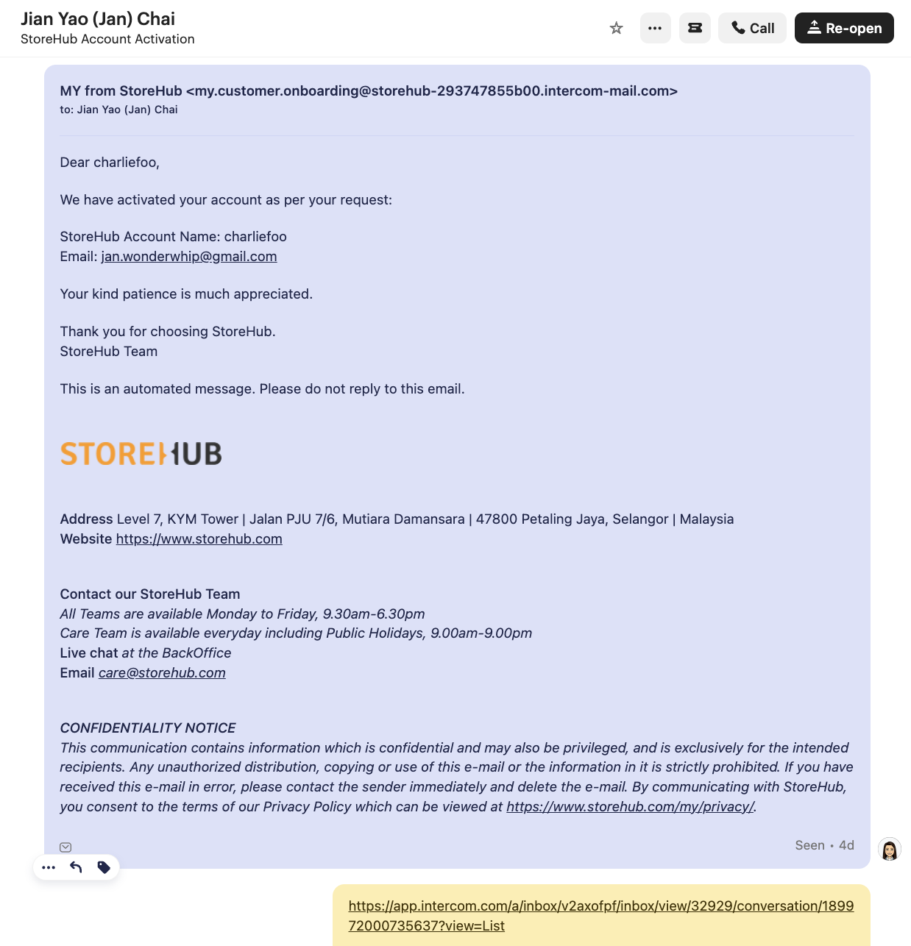
Intercom
Conversation Type
New Merchant Account Activation
Inform Merchant account has been activated.
Example ticket here

Slide 38

Intercom
Conversation Type (Cont.)
Product Setup (Submitted by Merchants)
Request submitted by Merchants using Jotform.
Merchant that purchase onboarding packages and has provided menu list for setup.
OE will work on Menu once Merchants account is activated.
OE has 2-3 days to complete setup Product Setup
Example ticket link

Slide 39

Intercom
Conversation Type (Cont.)
Product Setup (Submitted by Merchant Success Manager)
Request submitted by MSM using Intercom ticket.
Merchant that purchase onboarding packages and has provided menu list for setup.
OE will work on Menu once Merchants account is activated.
OE has 2-3 days to complete setup Product Setup
Example ticket link

Slide 40

Intercom
Conversation Type (Cont.)
QR collaterals
Request submitted AM and MSM via Jotform and it be parked at Onboarding team.
OE will work on Adobe InDesign to create collaterals.
Submit Collateral Printing Request Jotform.
Sample ticket here.

Slide 41
Adobe Illustrator (OE)

Slide 42




Adobe Illustrator
Introduction
To create QR Code for merchant
1. Toggle on both Beep QR and Beep Delivery in BackOffice.
2.Select a store to begin with the table QR
Settings > Account > F&B
Settings > Stores

Slide 43




Adobe Illustrator
Create QR Collaterals
3. Click on Sell this store’s inventory online
5. Go to Beep QR Ordering and click on New Request
4. Go to Tables, and create Table Layout

Slide 44




Adobe Illustrator
Create QR Collaterals
6. Select Import from Table Layout and Submit request
7. Log in to beeporder@storehub.com and download attachment
8. On the CSV file insert the word “Table” in front of each number
9. Once done, export to CSV

Slide 45




Adobe Illustrator
Create QR Collaterals
10. Launch Adobe InDesign app and import CSV
11. The file will appear with Table Sticker.indd file
13. Select the CSV file from Step 1 and click on ‘Open’
12. Click on the icon and ‘Select Data Source’

Slide 46




Adobe Illustrator
Create QR Collaterals
14. Click on Preview for the QR code to appear on screen
15. Export to PDF
16. Click on OK then Export; save file name as Merchants account name

Slide 47



Adobe Illustrator
Create QR Collaterals
17. Visit the sheet and refer to “Soft Copy + Collateral” or “Hardcopy” tab.
19. Go to File and click on Download; then select PDF
18. Fill in the quantity required in each column based on the request.
20. Go to File and click on Download; then select PDF

Slide 48

Adobe Illustrator
Create QR Collaterals
21. Submit Jotform
OE’s will need to submit Jotform after creating QR collaterals with Adobe Illustrator.
The request will be directed to Vendor Image Magic, who will handle the printing and dispatch of the materials to the merchants.

Slide 49
Forms

Slide 50

Forms
Account Activation Request
MSM will submit Account Activation requests through this form.
Request will be received by OE’s via Intercom to process the the activation on Chargebee.

Slide 51

Forms
StoreHub Collaterals Request Form
MSM will submit QR Collaterals requests through this form.
Request will be received by OE’s via Intercom to process the Collaterals for Merchants.

Slide 52

Forms
Collateral Printing
OE will submit this form once QR collaterals has been created using Adobe Illustrator.

Slide 53


Supply Chain
[ Team Using : Supply / Care ]

Slide 54




Supply Chain
Overview
Introduction
Salesforce
Oracle Netsuite
Delivery Issue

Slide 55


Supply Chain
Introduction
Look out for latest announcements on updates related to:
Supply Chain: Hardware related updates
Business Process: Work process updates
Workplace: CPM Announcement
Click Like for acknowledgement or post question related on the topic posted by the CPM Team

Slide 56






Supply Chain
Introduction
Vendors Used

Slide 57

Supply Chain
Oracle Netsuite
Dashboard

Slide 58
Supply Chain
Quotation & Order Creation
Salesforce
Netsuite
Create Quote
Email Quote & follow up payment
Create Order
Attach Payment Slip
Sales / Success
Approve and activate order
Sync into Netsuite Sales Order
Finance
Update Netsuite Memo as Software / Hardware / Software + Hardware
Close SO
Generate invoice and send to merchant
Process SO & Arrange Hardware Delivery.
The delivery details (tracking link or number) will be synced into SF through integration on daily basis (Salesforce x Vendor Gsheet Integration)
Supply Chain
SO = Sales Order

Slide 59


Supply Chain
Tracking Number in Salesforce
Use Salesforce to search for Supply Chain information such as
Transport Type
Tracking Number / Tracking Link
Delivery Status & Timestamp
SalesForce order dashboard - Here

Slide 60
Supply Chain
Hardware Delivery
Hardware Delivery SLA
Within Klang Valley: Delivery Provider: Lalamove (Default) Same day between 3.00pm - 5.00pm | Outside Klang Valley: Delivery Provider: GDEX Peninsular: Between 3 - 5 days East Malaysia: Between 5 - 7 days
Onsite Service SLA
Case / Ticket creation in Tracking: Cut-off time is 12.00pm daily Tier 2 will contact merchant within 1-2 working days to arrange for visit.
State | Portal Request Date (by StoreHub) | Appointment Contact Day By Engineer (working day) | Target Engineer Appointment Date (Depending on agreed Date)
Selangor / KL | Wednesday before 12.00pm | Thursday (next day) | Friday
 | Wednesday after 12.00pm | Friday (day after next) | Monday
Kelantan / Terengganu / Kedah (Weekend: Friday & Saturday) | Wednesday before 12.00pm | Thursday (next day) | Sunday
 | Wednesday after 12.00pm | Sunday (day after next) | Monday
SLA = Service Level Agreement

Slide 61

Supply Chain
Escalation Flow for Hardware Delivery
Merchant’s Responsibility:
Check all items delivered
Check physical condition of goods delivered
Take clear picture of parcel / item if damaged
Malaysia
Damaged Parcel / Missing Item | Defective Unit
Within 1 working day of receiving Parcel | Within 14 days of receiving parcel
Contact Salesperson/ Success:
Raise ticket to Supply Chain by sending email to care@storehub.com
Contact Merchant Care Team:
Merchant Care team to raise internal note with @businesssupport
SurfsTek & iMin MAY NOT entertain if report is given past 3 working days
If there are any issues, Merchant to take all the evidence, keep all original packaging and content for the reverse pick-up.

Slide 62


The Platform for Awesome Businesses
The End
THIS DOCUMENT IS STRICTLY PRIVATE AND CONFIDENTIAL. THIS IS INTENDED FOR INTERNAL USE ONLY; DO NOT CIRCULATE
Copyright © 2022 StoreHub. All rights reserved. No parts of this document can be reproduced, distributed, transmitted or stored electronically without StoreHub’s prior written permission.
21

